Slide 1
SAP HANA - Introduction

Slide 2
What is SAP HANA?
SAP HANA is a flexible, data-source-agnostic appliance that enables customers to analyze large volumes of data from SAP and non-SAP systems in real-time, avoiding the need to materialize transformations.
SAP HANA appliance software is a hardware and software combination that integrates a number of SAP components including the SAP HANA database and several replication systems: SLT (SAP Landscape Transformation) Replication Server, SAP HANA Direct Extractor Connection (DXC) and Sybase Replication technology.
The SAP HANA database is a hybrid in-memory database that combines row-based, column-based, and object-based database technology. It is optimized to exploit the parallel processing capabilities of modern multi-core CPU architectures. With this architecture, SAP applications can benefit from current hardware technologies.

Slide 3
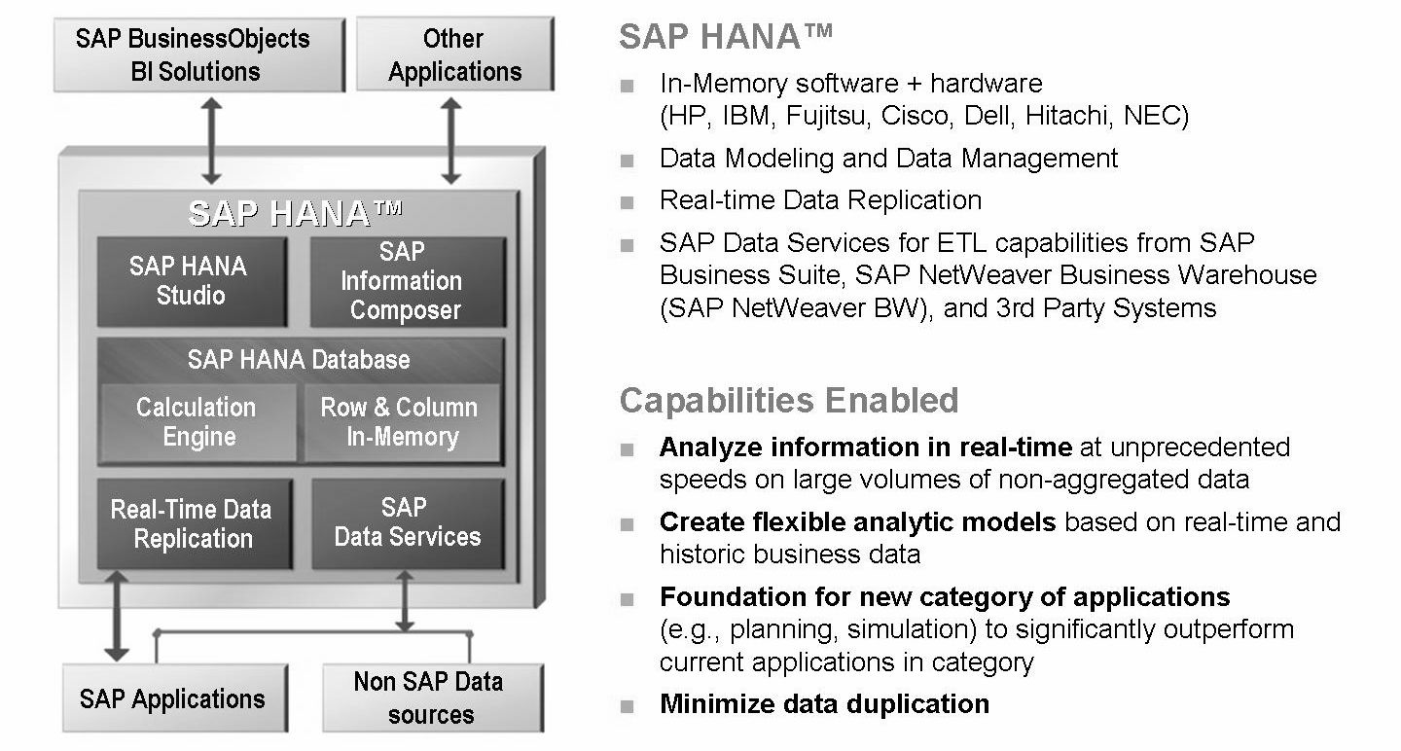
SAP In-Memory Appliance (SAP HANA)

Slide 4
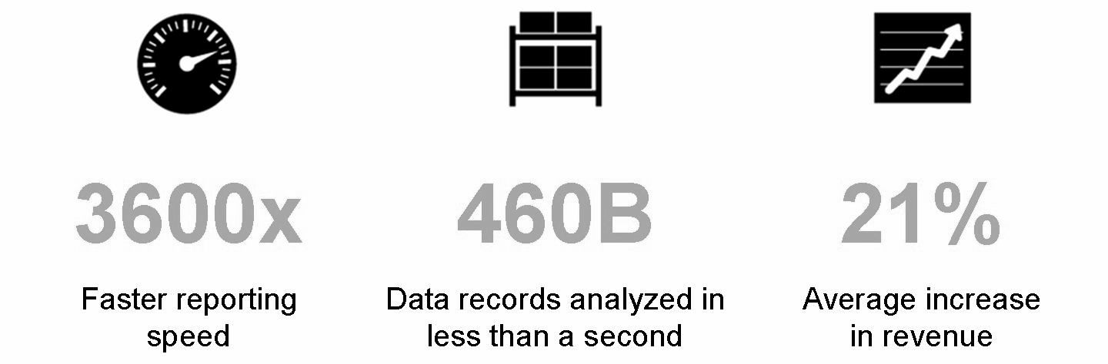
SAP HANA Proof Points
According to a study by Oxford Economics, companies that implement real-time systems see an average 21% revenue growth, and a 19% reduction in IT cost.

Slide 5
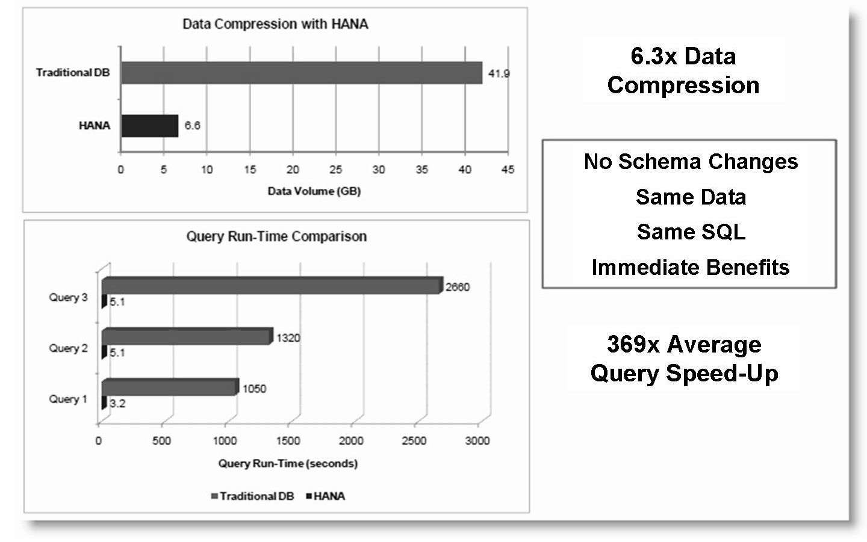
Query Acceleration Example - Large Bank - 1 Month of Customer Information

Slide 6
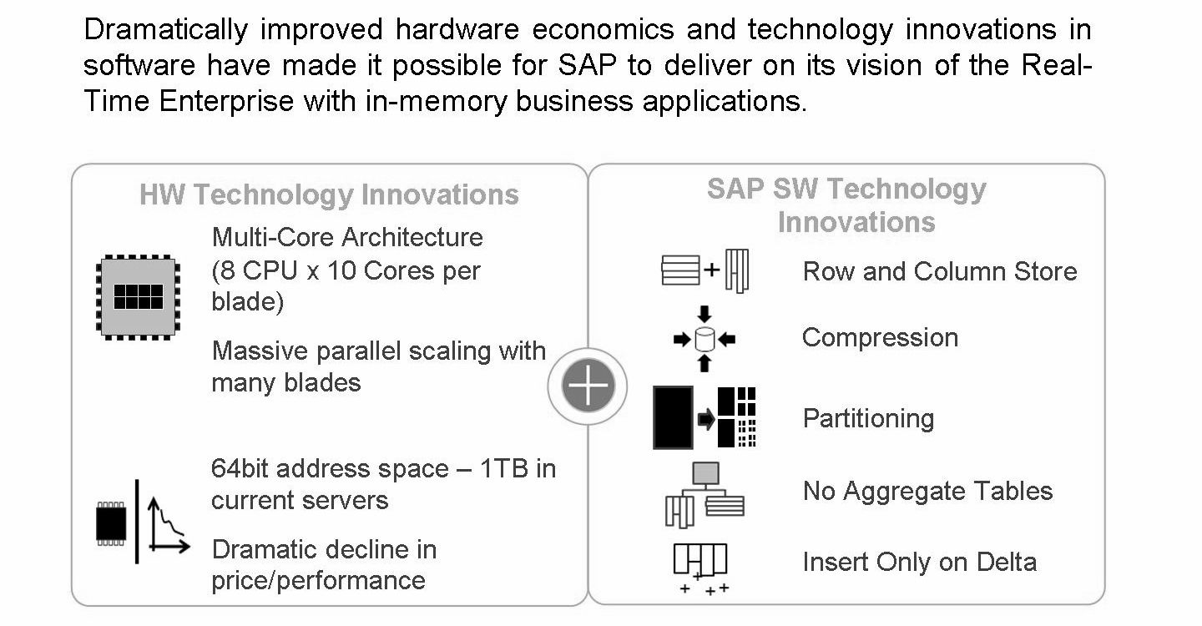

Slide 7
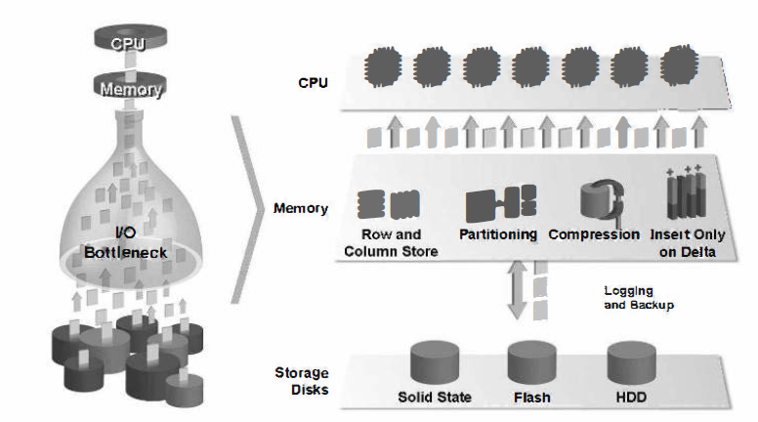
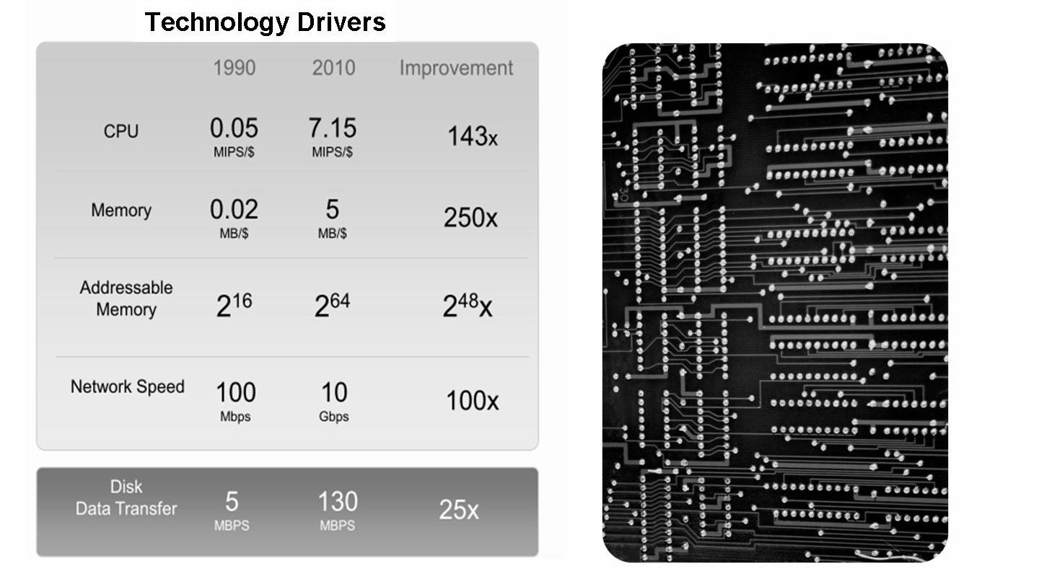
Why In-memory?

Slide 8
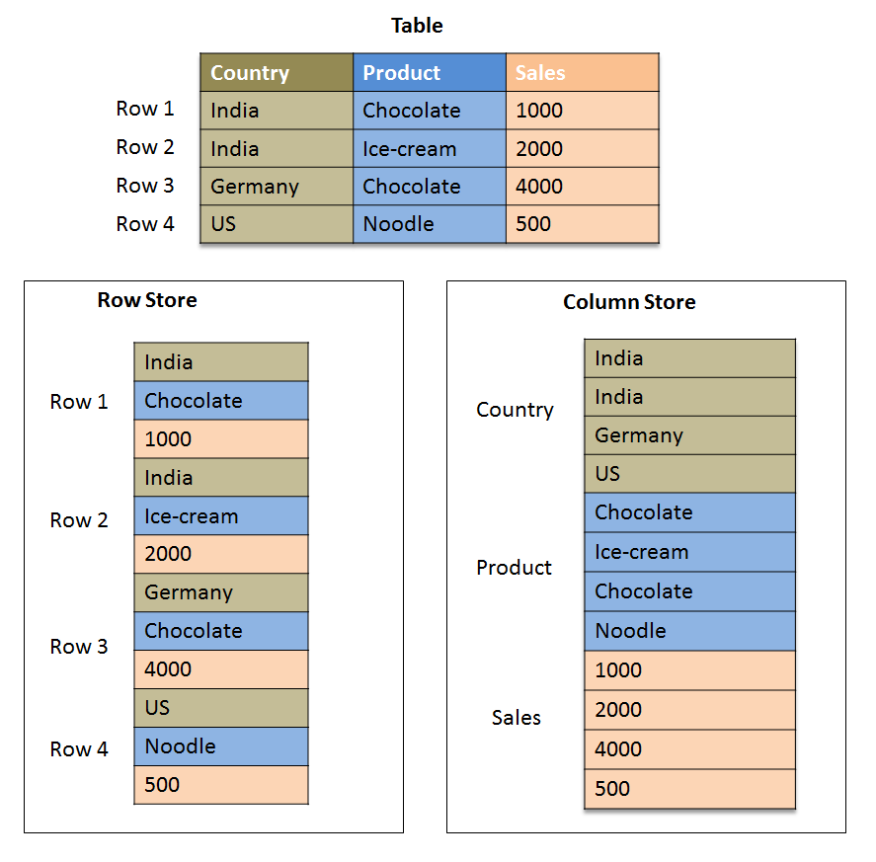
Column Data Storage

Slide 9
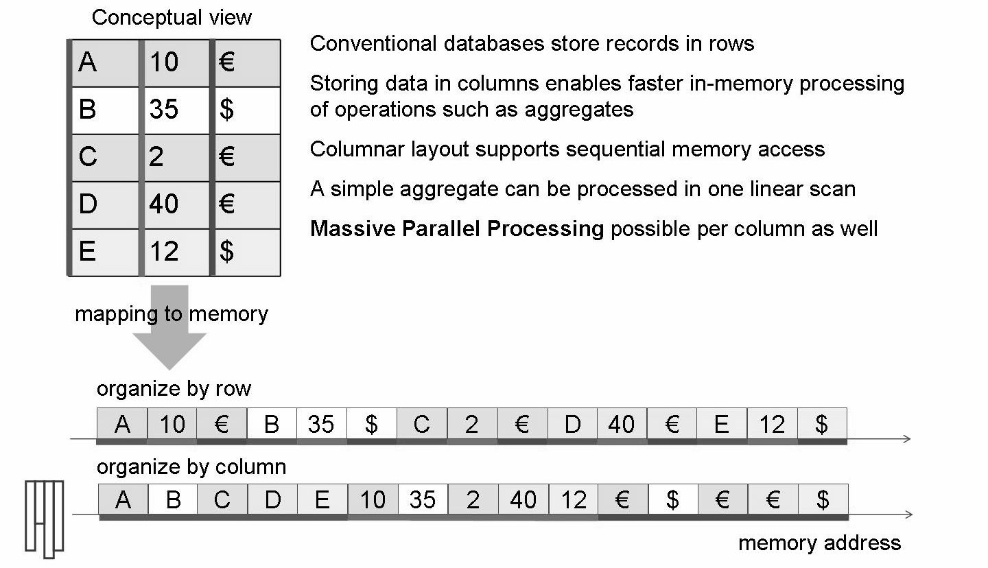
Fast - SW Side Optimization for Memory

Slide 10
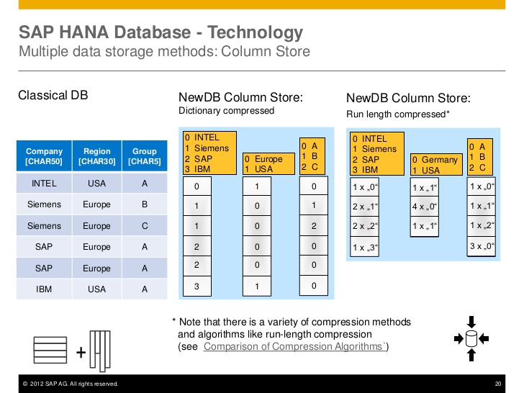

Slide 11
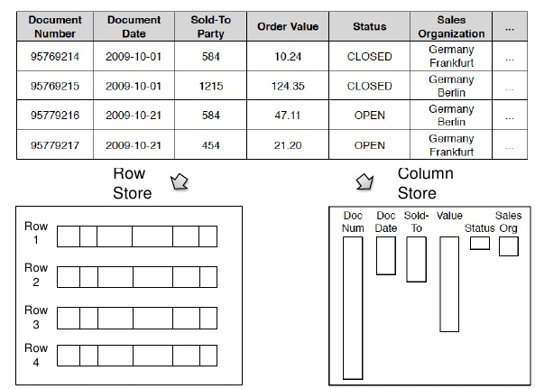

Slide 12
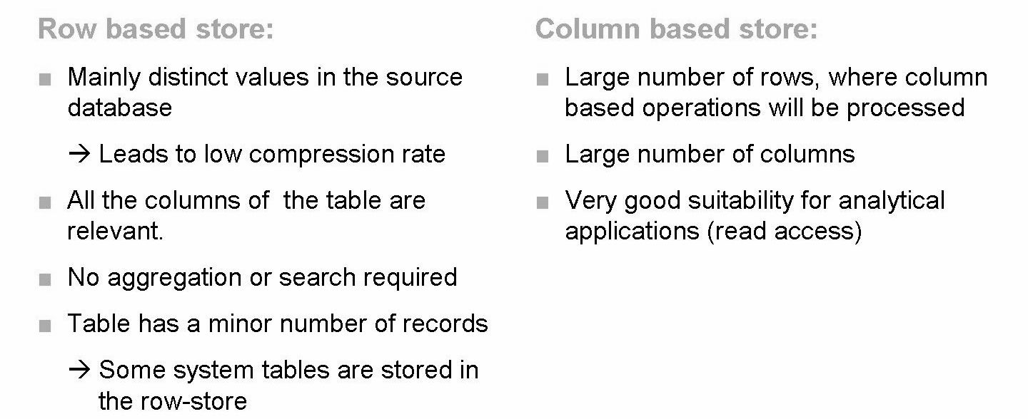
Key Facts: When to Use Row Store, when Column Store?
If you want to report on all the columns then the row store is more suitable because reconstructing the complete row is one of the most expensive column store operations.
If you to want to fill the table with huge amounts of data, that should be aggregated and analyzed then a column store is more suitable.

Slide 13
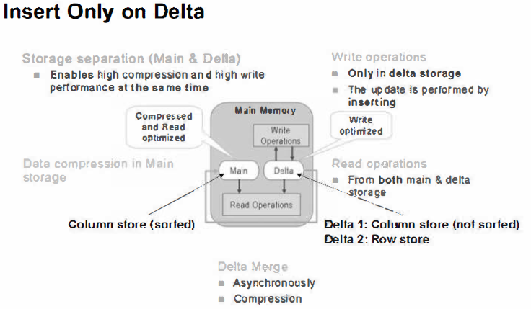

Slide 14
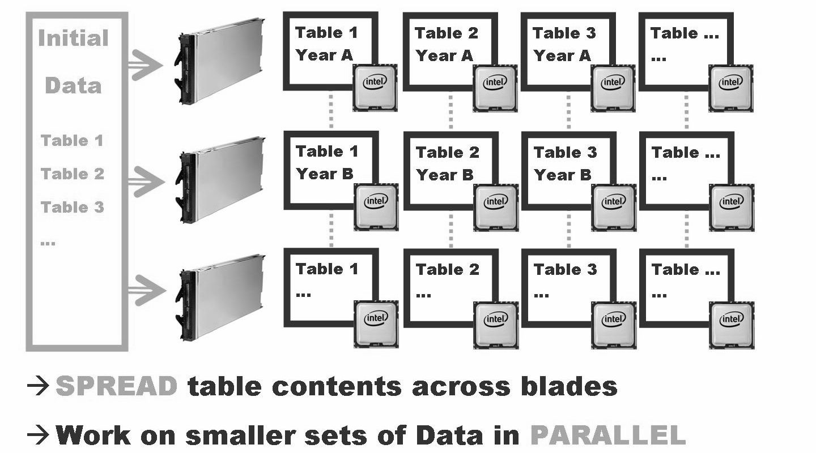
Partitioning

Slide 15
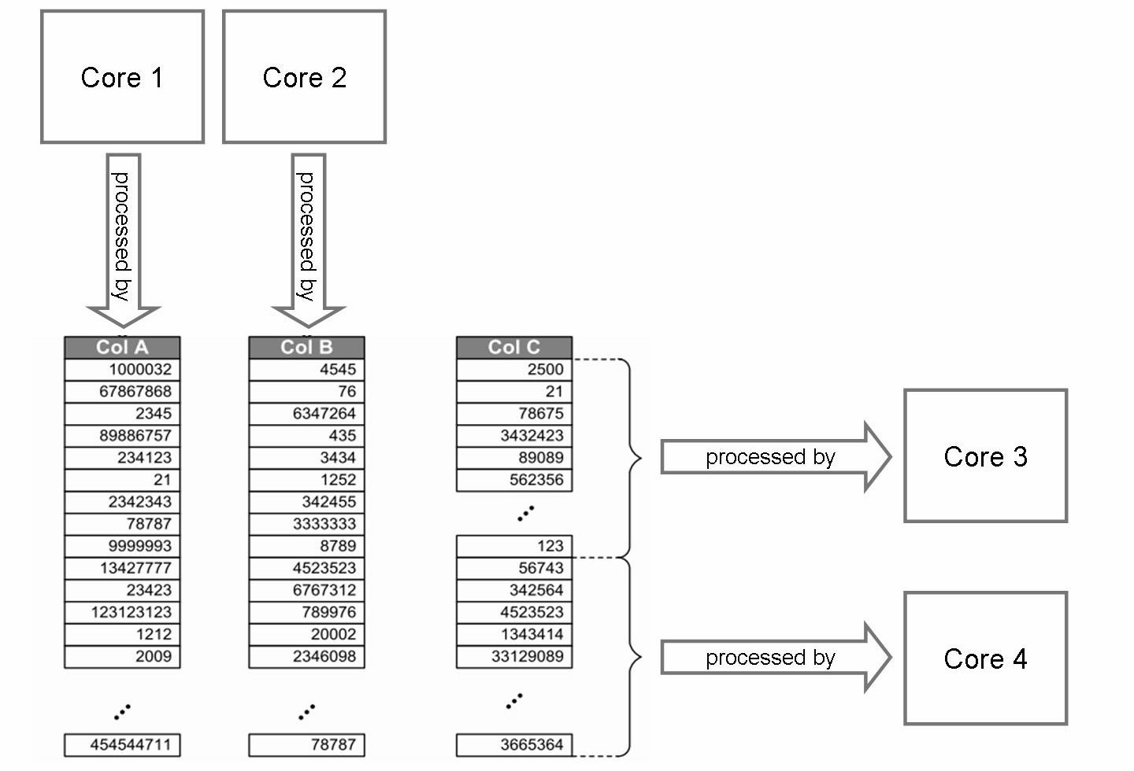
Parallel Processing

Slide 16
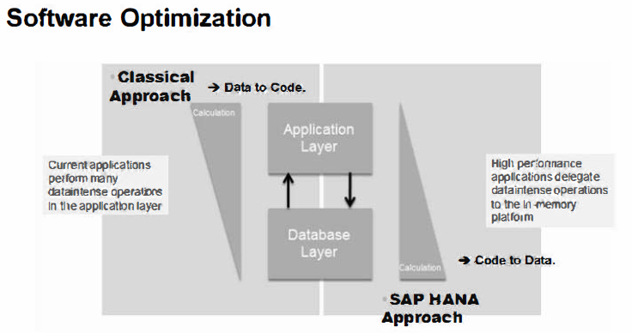
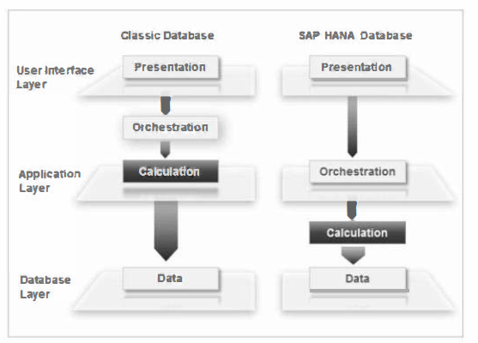

Slide 17
SAP HANA Scenarios

Slide 18
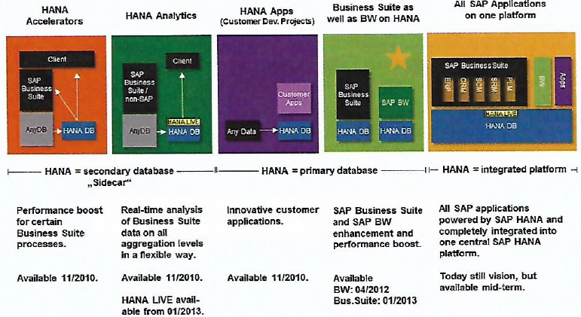

Slide 19
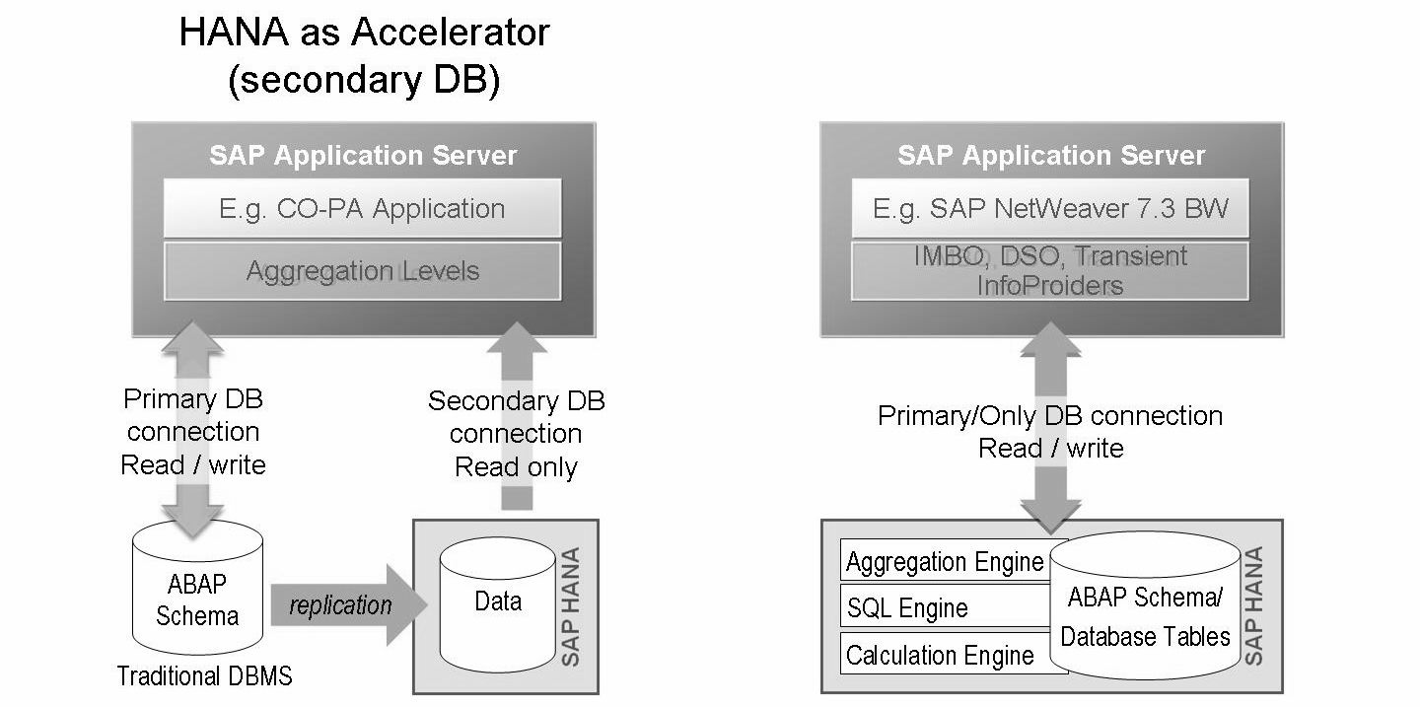
Application Server ABAP Based Scenarios - HANA as Secondary Database (for AS ABAP)
Example: CO-PA Accelerator, Cash Forecast Accelerator

Slide 20
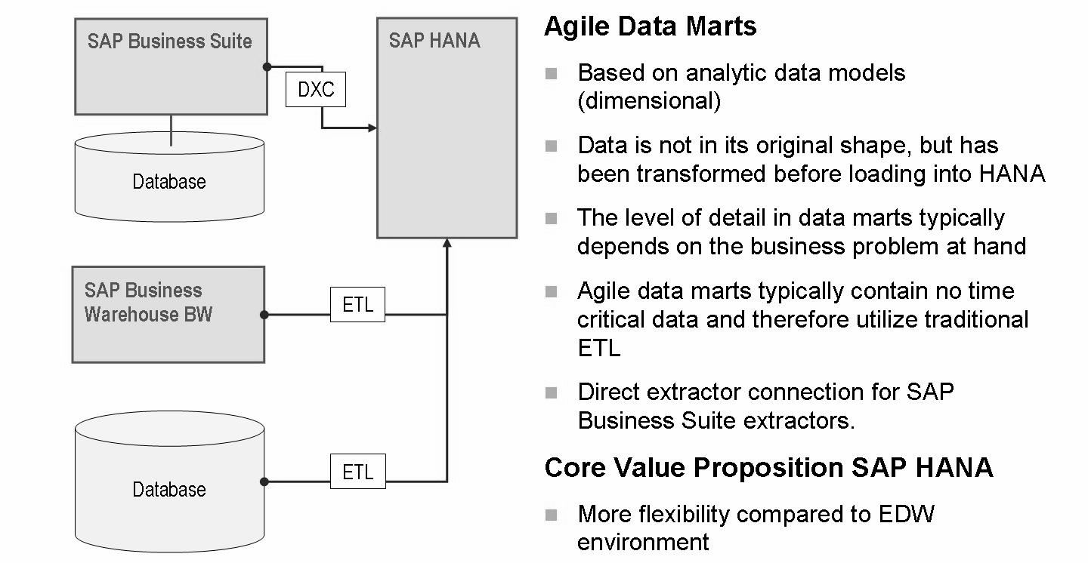
SAP HANA Scenarios: Agile Data Marts

Slide 21
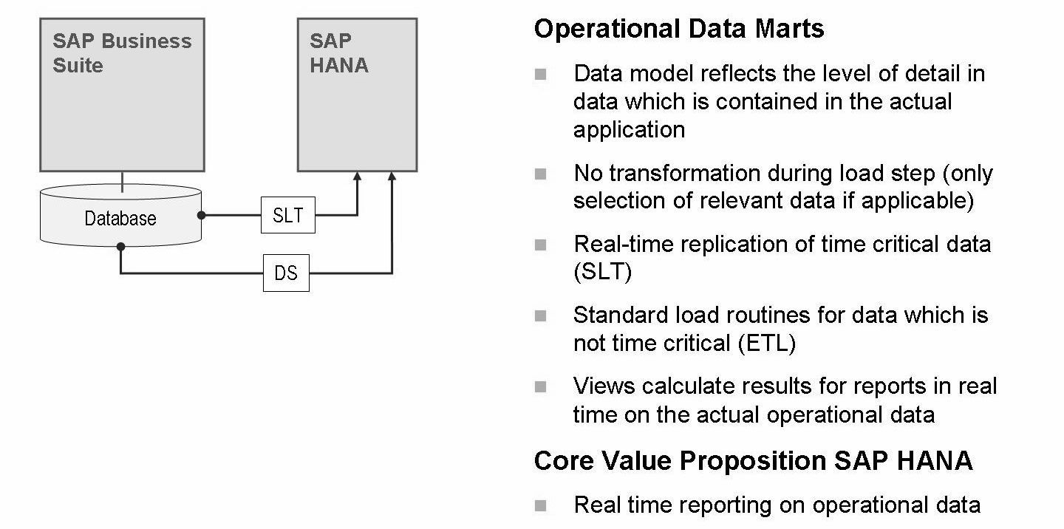
SAP HANA Scenarios: Operational Data Marts

Slide 22
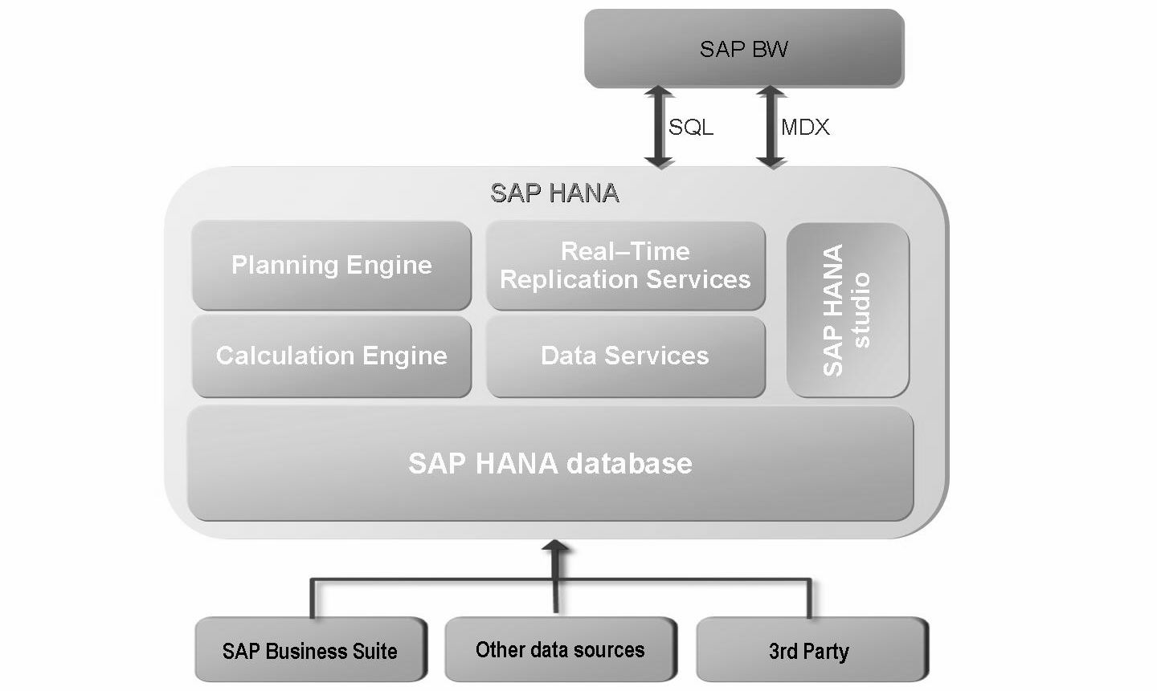
SAP BW on HANA
BW on HANA was delivered with SPS04 in 2012.
Before database migration to HANA DB the BW application has to be updated to 7.31.
The system usage is the same like BW 7.31 on non SAP databases.

Slide 23
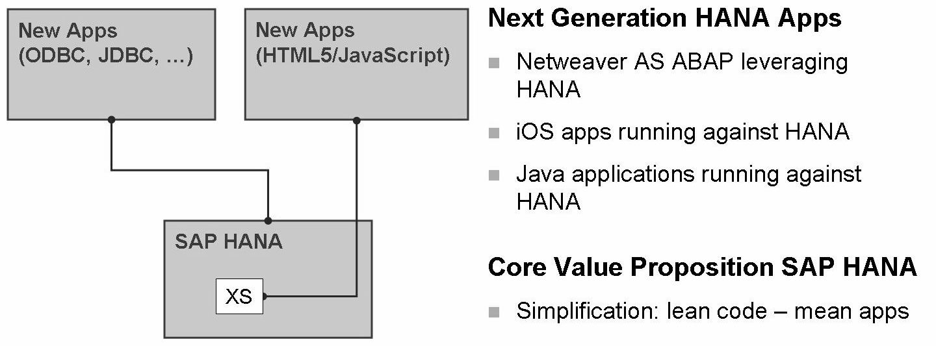
SAP HANA Scenarios: Transformation scenario / SAP HANA as platform

Slide 24
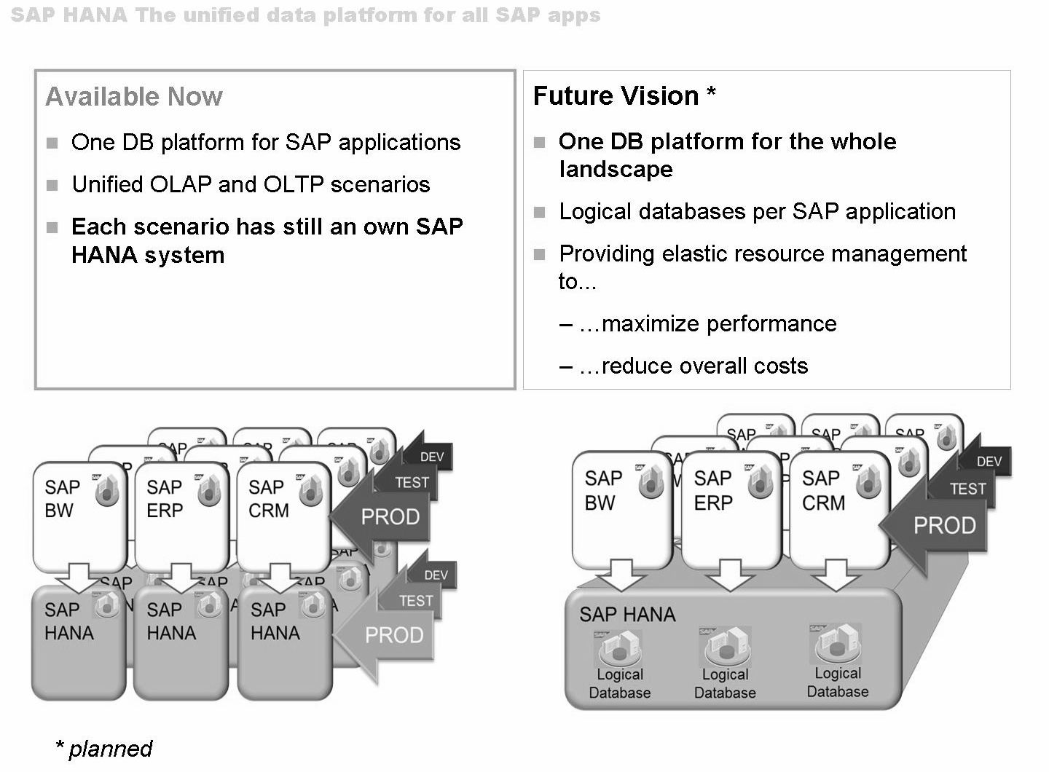
SAP HANA unified data platform

Slide 25
THANK YOU

